Slide 1
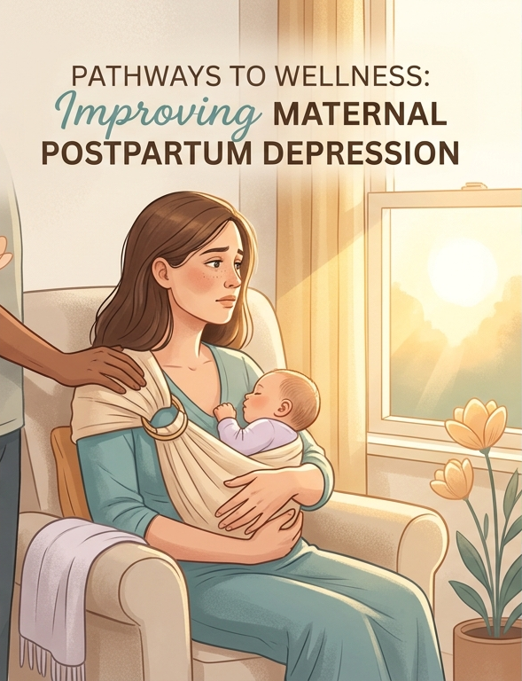

A focus on the inadequate postpartum support U.S. mothers receive, which often contributes to the development of PPD.
By Ani Boateng
ENGL 1302

Slide 2


PROBLEM OVERVIEW
Postpartum depression (PPD) affects many mothers, but it often goes unnoticed due to limited education. Symptoms can be hidden in social isolation and portrayal of a good mom image.
Untreated maternal mental health issues can endanger mothers and impact child development.
Press play to play audio

Slide 3

Why this problem matters
Maternal mental health is essential to a family’s well‑being, yet it is often overlooked after childbirth. When a mother’s mental health is neglected, it affects her safety, the baby’s development, and the long‑term stability of the society.

Slide 4
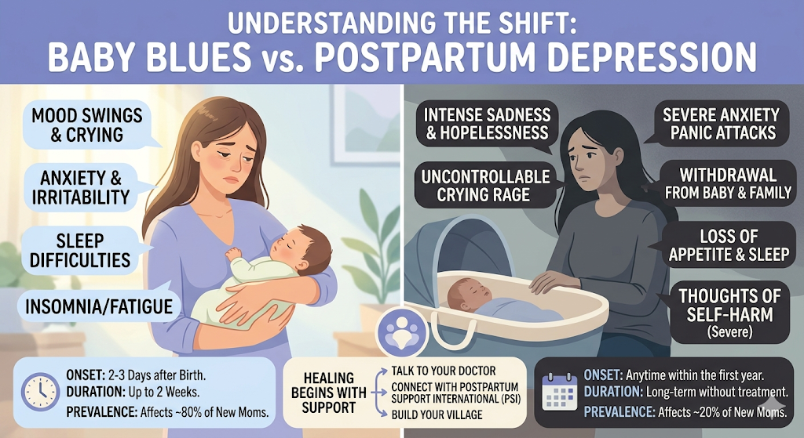
UNDERSTANDING THE SHIFT: BABY BLUES vs. POSTPARTUM DEPRESSION
Baby blues are a normal part of the postpartum experience and usually resolve on their own without medical intervention.
Conversely, PPD is a prolonged condition that often requires support and professional treatment.

Slide 5

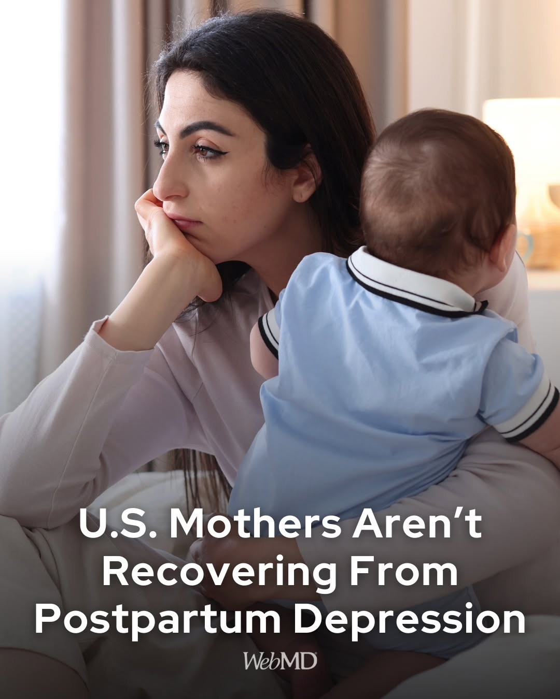
WHO IS AFFECTED
Mothers, especially first‑time moms are highly vulnerable to PPD.
Around 70–80% of new mothers experience short‑term mood swings after childbirth.
Unlike baby blues, PPD can appear during pregnancy or up to a year after birth and can affect any mother.

Slide 6

Key Statistic
The baby blues affect up to 80% of mothers, while about 20% experience clinical depression during or after pregnancy.
PPD often begins before birth, and roughly up to 1 in 5 women develop PPD.
Press play to play audio

Slide 7
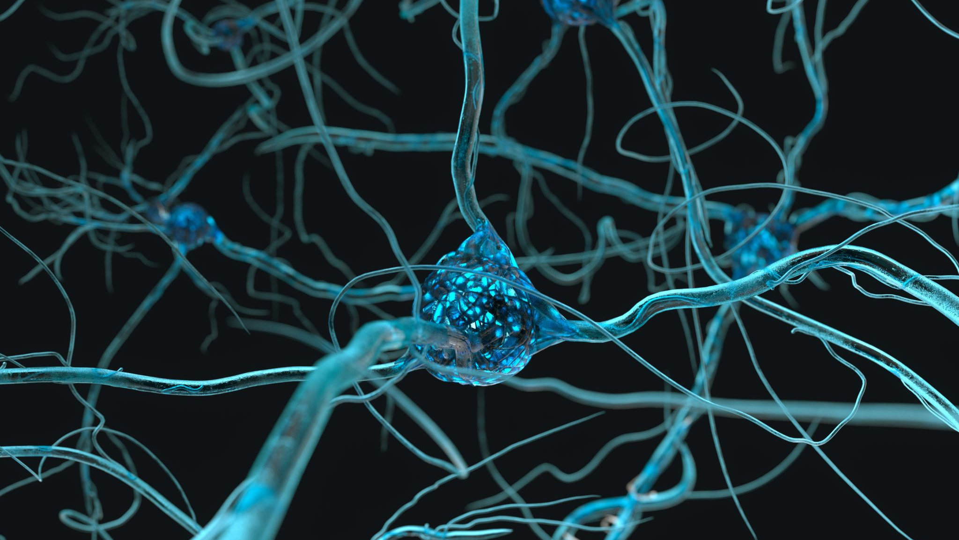
Root CAUSES of PPD
- Little to no help after birth
- Poor postpartum conditions like sleep deprivation
- Hormonal shifts
- Financial or relationship stress

Slide 8
WHAT PEOPLE COMMONLY ASSUME
“Before having my son, I assumed that if you come home from the hospital and don’t feel depressed, you’re ‘in the clear’ Postpartum always looked like a mom who is bedridden, weeping or unable to care for her baby.”
- Jemima Essien ( SFA alumni, mother of one)
Press play to play audio

Slide 9

Why people’s assumptions fall short
After birth, some mothers feel well for months before symptoms emerge.
Intrusive thoughts can increase vigilance, not lack of love.
PPD is clinical, hence waiting for it to fix itself is unsafe and can lead to chronic depression.
Press play to play audio

Slide 10

PROPOSED SOLUTIONS
There should be paid and long parental leave from 12 weeks to one year.
Families should create postpartum plans assigning support tasks.
Mental health professionals should be placed in OB‑GYN and pediatric clinics.
Insurance companies should cover postpartum doula services.
Press play to play audio

Slide 11
BEST SOLUTION
Systemic and Social Support:
Families should prepare a postpartum plan that assigns support tasks like night feedings and grocery runs before the baby arrives.
Mothers should be given up to one year of paid leave, since returning to work at six weeks increases PPD risk.

Slide 12

HOW THIS SOLUTION WOULD WORK
A GUIDE FOR THE VILLAGE/SUPPORT PEOPLE:
Assign someone to handle invisible chores like dishes, laundry, and trash.
Give the mother a daily two‑hour protected nap while someone takes the baby elsewhere.
Set up a meal train with no‑knock porch drop‑offs.

Slide 13
HOW THIS SOLUTION WOULD WORK
LONG PARENTAL LEAVE RECOVERY ROADMAP
Maternal leave should last 12 weeks to one year so mothers can heal and bond with their babies.
Both leaves must be paid and job‑protected to reduce financial stress and PPD risk.
Fathers should get at least 12 weeks of leave to support the mother’s recovery.

Slide 14

EVIDENCE IT WORKS ELSEWHERE
This video shows how social support from “the village” (partner) helps improve PPD.
Video Credit: bet (Interview with American actor KJ Smith-Black)
Press Play to play this video

Slide 15
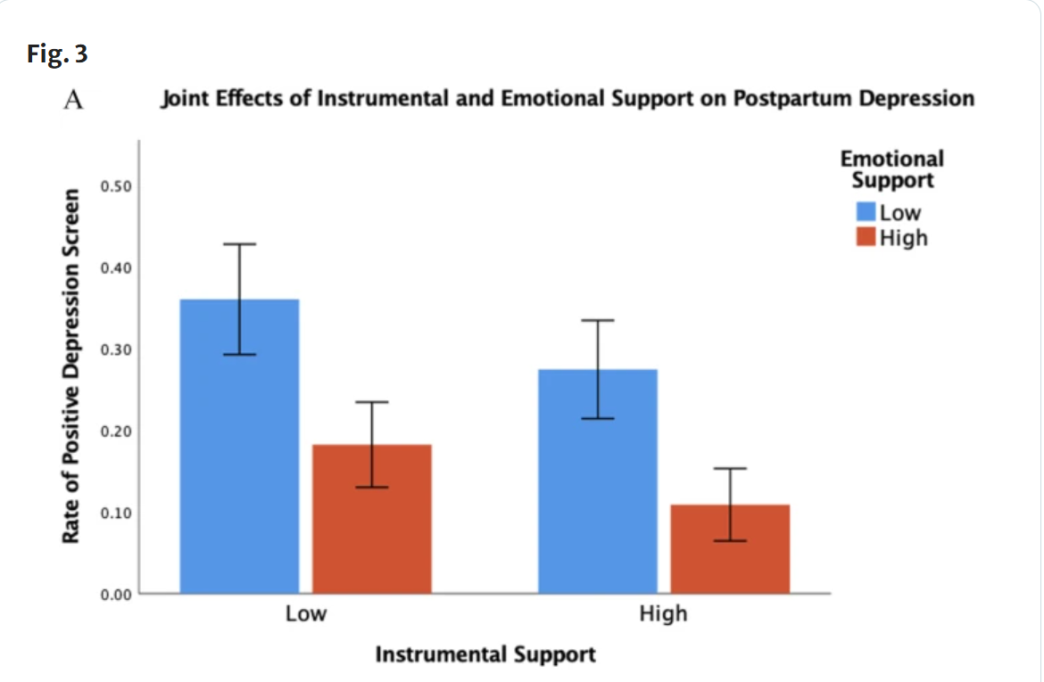
EVIDENCE IT WORKS ELSEWHERE
“This figure shows the joint effects of emotional and practical support predicting PPD. Both variables were split into high and low (median split) groups. Emotional support only predicted depression for women reporting low practical support, indicating that PPD risk increases with low practical support”.

Slide 16
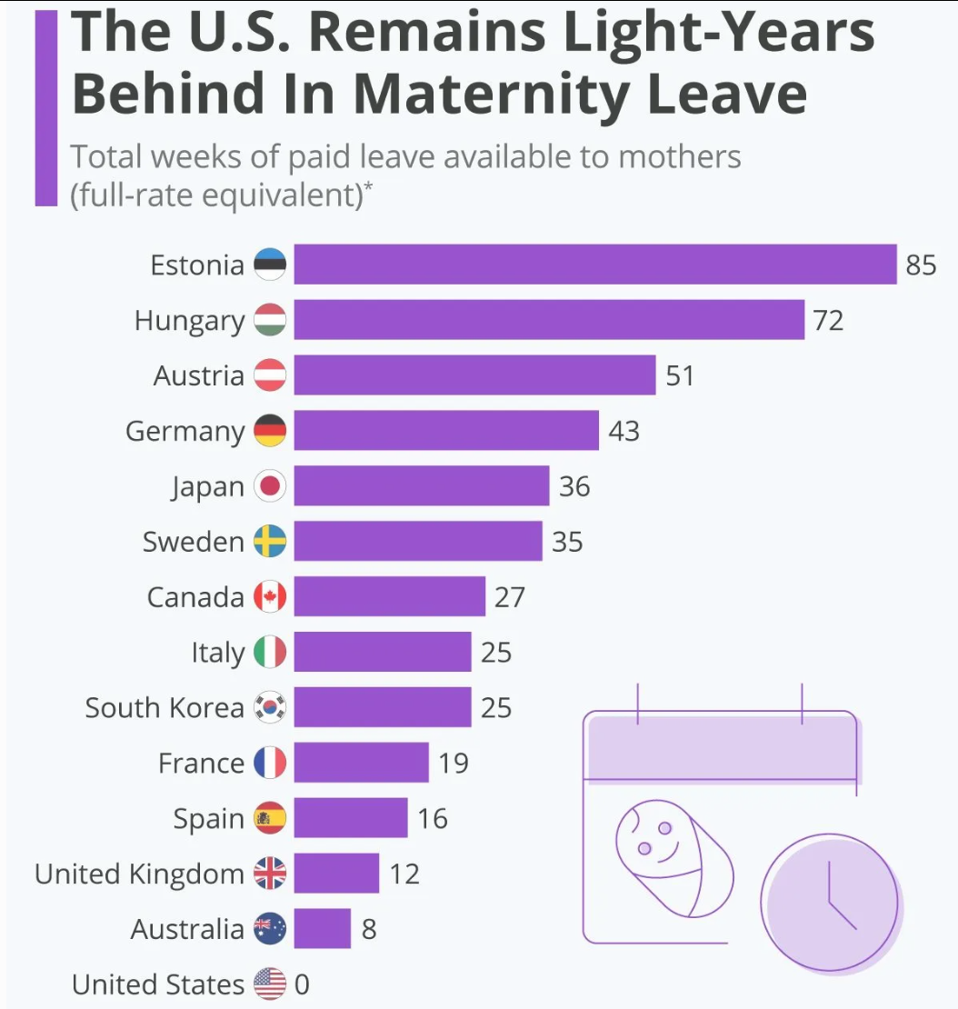
EVIDENCE IT WORKS ELSEWHERE
International Comparisons: In countries with national paid leave (like Sweden), the "peak" of postpartum mental health crises is significantly lower than in the U.S., where "return-to-work" pressure often triggers PPD.

Slide 17
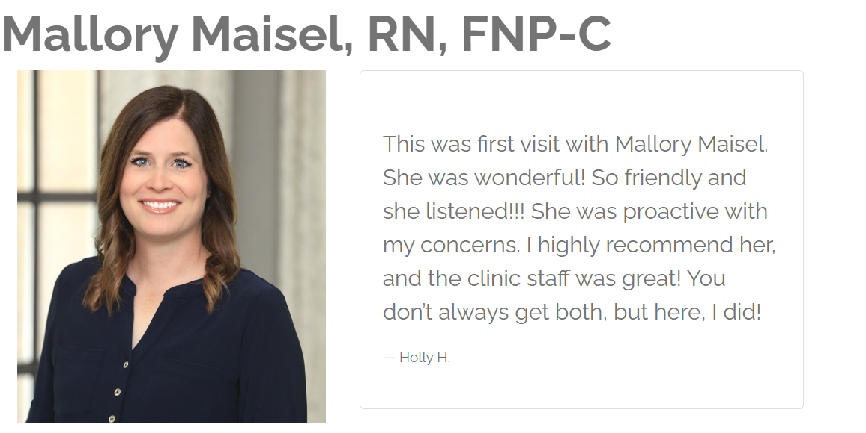
EXPERT OR AUTHORITY SUPPORT
“Many mothers miss PPD warning signs because overwhelm feels expected, so we teach symptoms before they go home.”
Support during postpartum isn’t a luxury but a medical necessity for recovery.
At least a paid 12‑week leave would ease early stress and sharply reduce PPD”.
Mallory Maisel, RN, FNP-C
Nacogdoches Women’s Center
Press play to play audio

Slide 18

COST, FEASIBILITY
Prolonged paid leave of 12 weeks or more is a costly but high-impact investment that reduces return-to-work anxiety and boosts productivity.
Also, practical help from family or community offers a low cost, highly effective way to ease maternal stress and prevent burnout.

Slide 19
Addressing counterarguments – the village
Some fear “the village” overwhelms new mothers, but real support protects privacy. Tasks like quiet meal drop‑offs or laundry eases her load.
Some argue “the village” no longer exists, but when family is distant, we can build support through neighbors, or virtual communities.
Press play to play audio

Slide 20
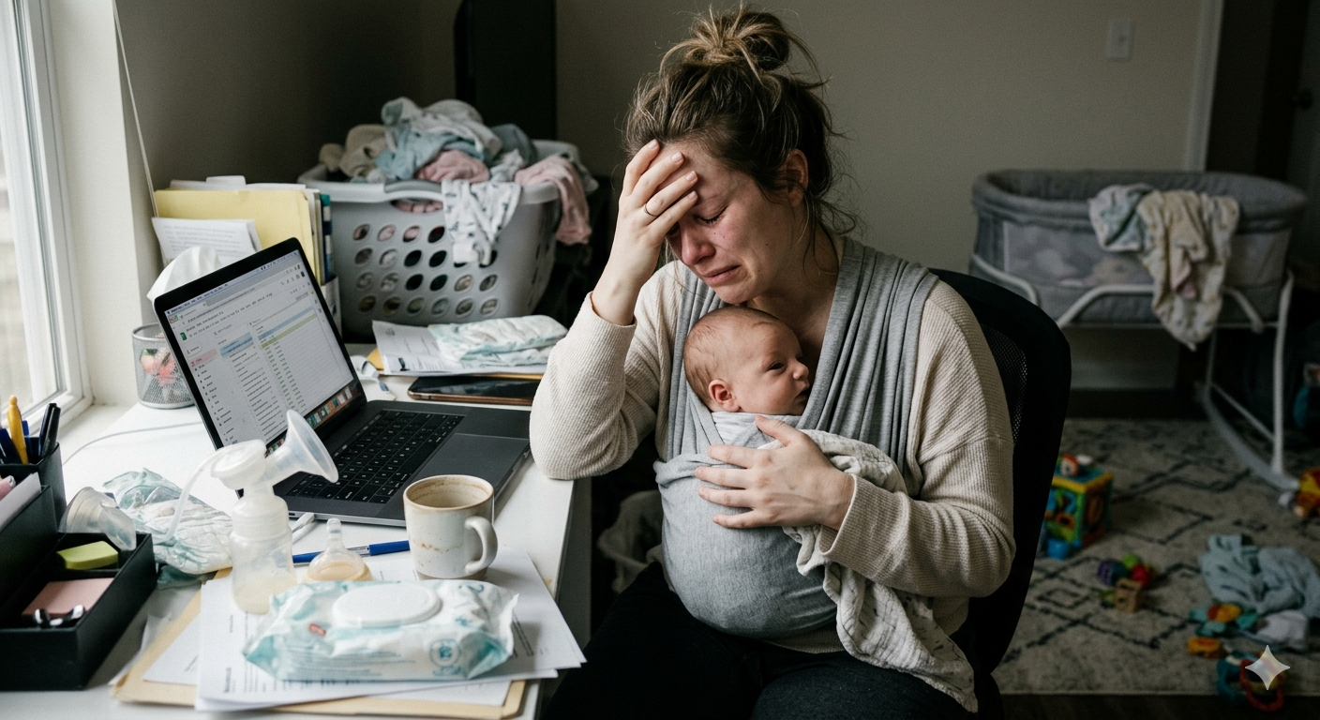
Addressing counter arguments – LONG PAID LEAVE
People argue that small businesses can’t afford paid leave, yet it boosts mothers’ return rates by 20%, saving costly recruitment.
People worry that paid leave raises taxes, yet untreated PPD costs billions in lost productivity, making extended leave a preventative, cost‑saving investment.
This AI generated image shows a new mother working on her laptop virtually while clearly distressed.
Press play to play audio

Slide 21
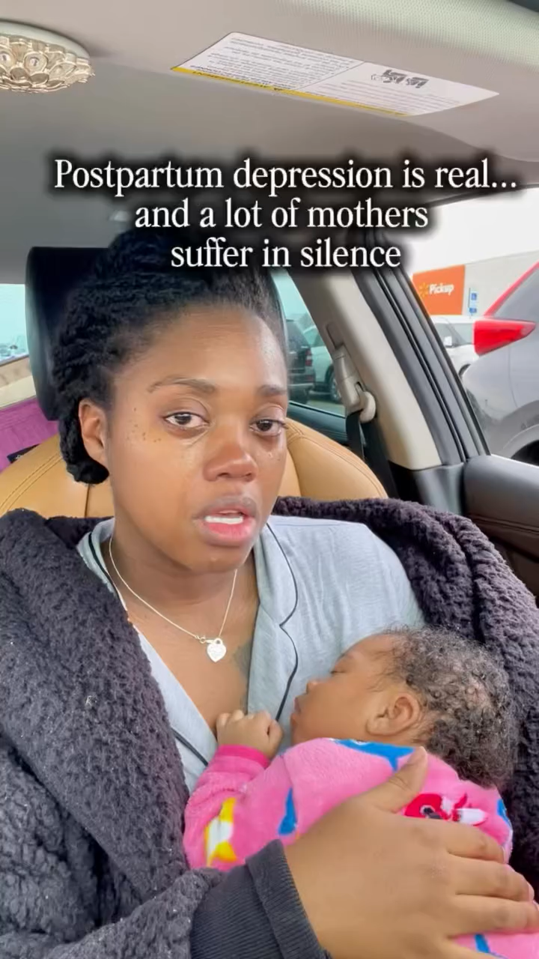
MESSAGE OF HOPE
A CALL TO ACTION
Set up a "no-knock" meal train for an expecting family.
Ensure protected naps for a new parent.
Prioritize mother‑focused check‑ins.
Urge an employer to expand parental leave policies to a minimum of 12 paid weeks.
Share the "1 in 5" statistic to reduce stigma
Press play to play audio

Slide 22
Works cited
Shedding light on maternal mental health in LMICs: a cornerstone of maternal and child health care https://pmc.ncbi.nlm.nih.gov/articles/PMC11557746/ . Accessed 3 March 2026
About Maternal Mental Health Disorders https://policycentermmh.org/mmh-disorders/ Accessed 3 March 2026
Maternal Mental Health Leadership Alliance (MMHLA). "Fact Sheets: Components of Mental Health and Wellness for Pregnancy and Postpartum." MMHLA, 2025, www.mmhla.org/fact-sheets.
World Health Organization (WHO). "Guide for Integration of Perinatal Mental Health in Maternal and Child Health Services." WHO Publications, 2025, www.who.int/publications/i/item/9789240057142.

Slide 23
Works cited
Beck CT. Postpartum depression: it isn't just the blues. Am J Nurs. 2006 May;106(5):40-50; quiz 50-1. doi: 10.1097/00000446-200605000-00020. PMID: 16639243. https://pubmed.ncbi.nlm.nih.gov/16639243/
Niall Mccarthy, [Infographic] https://www.forbes.com/sites/niallmccarthy/2021/05/31/the-us-remains-light-years-behind-the-rest-of-the-world-in-maternity-leave-infographic/
[Infographic] https://link.springer.com/article/10.1007/s00737-023-01330-3
AI Prompts: Slide 1: Generate an image that depicts a title of improving maternal post partum depression
Slide 4: Generate an image comparing PPD to baby blues
Slide 20: Generate an image of a new mother going to work with her baby or working with her baby while looking very distressed.

